Slide 1

Time Series Classification where next?
Tony Bagnall
A.J.Bagnall@soton.ac.uk
School of Electronics and Computer Science
University of Southampton

Slide 2
Real World Time Series Classification
Explainable AI for TSC
Ordinal and early classification
Unequal length series
Imbalanced classes
Multivariate series
Data archives

Slide 3
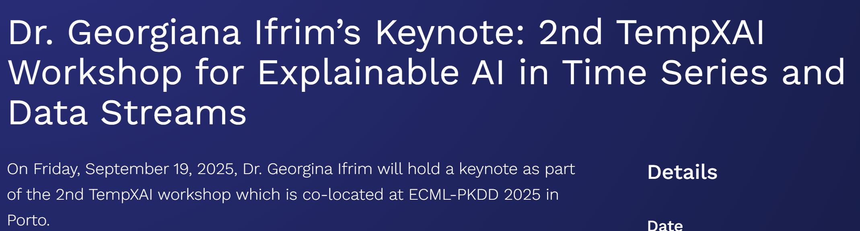
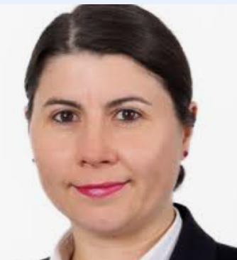
Explainable TSC
Plenty of work going on here, mostly with neural networks
Layer-wise Relevance Propagation (LRP) and SHapley Additive exPlanations (SHAP) variants
Tools such as TSInterpret/TimeSHAP, tscaptum

Slide 4
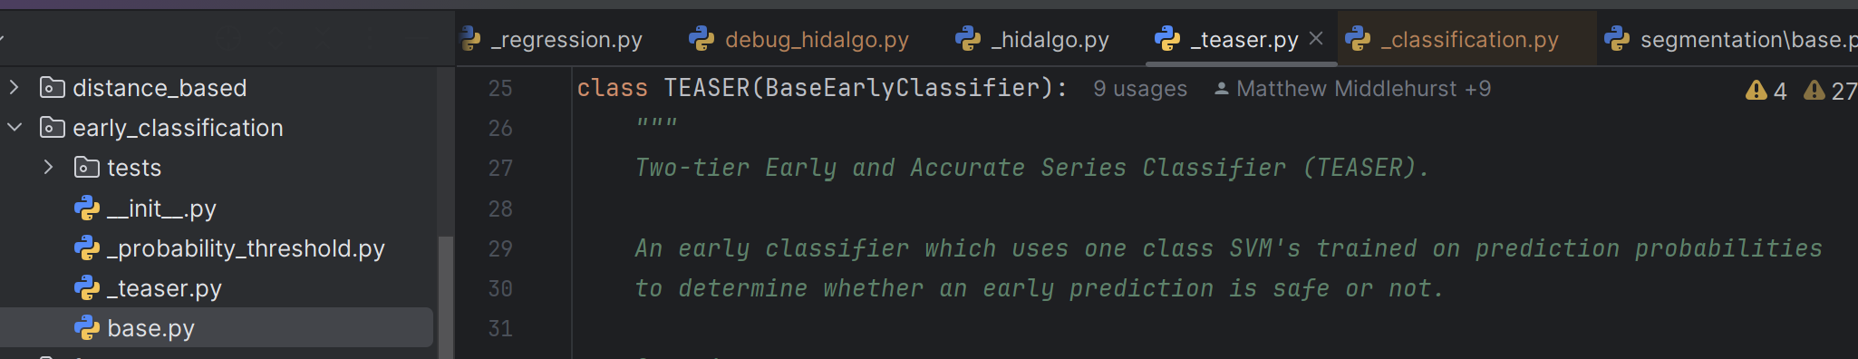
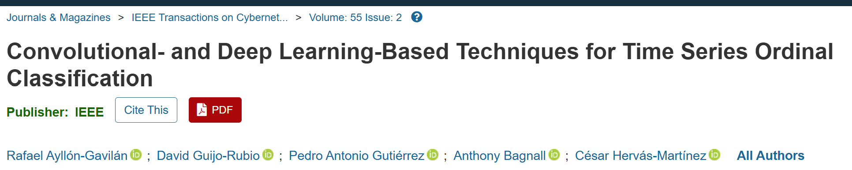
Ordinal and Early TSC

Slide 5
Unequal length

Slide 6
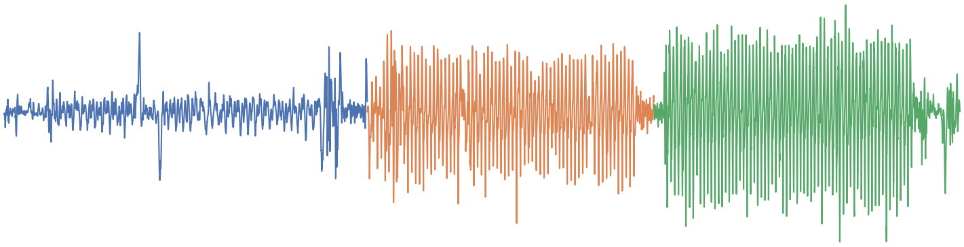
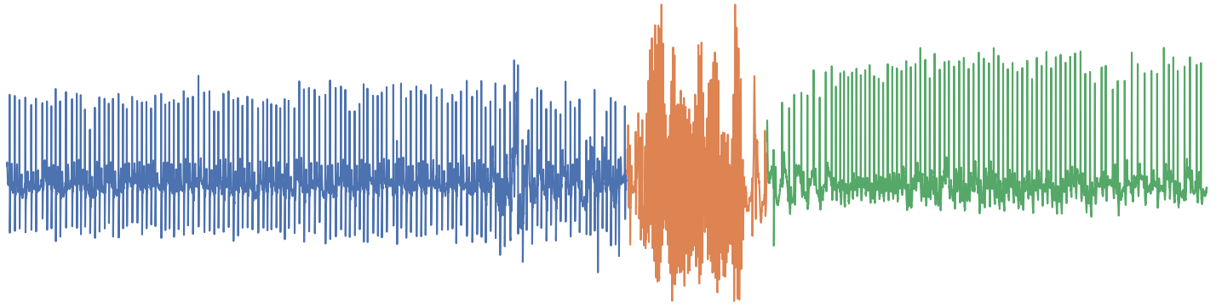
Unequal Length Data
Unequal length is a common occurrence particularly in segmented data
Minor variances in recording start and end and/or activity times will vary the amount of time points present.
1st split at
timepoint 3800
jog
2nd split at
timepoint 6800
run
walk

Slide 7
Unequal Length Series Preprocessing
Padding – add extra values to smaller series. Adds noise and useless values which may confound algorithms
Unequal length series
Truncation – remove values from larger series. Destructive, can easily remove informative sections
Resize – stretch data i.e. linear interpolation. Can change the shapes seen in the series

Slide 8
Issues with Padding - Examples
Shapelets are extracted from series, adding padding will likely result in wasted resources as shapelets are extracted from it. Without thew addition of noise, the padding shapelets will also give a distance of 0 to any other padding.
Good Match
OK Match
Bad Match

Slide 9
Issues with Padding - Examples
Could encode some information about the original length, but not really useful. If any legitimate shapelets look like the padding, they may be overrepresented.
Perfect Match
Perfect Match
Ok Match

Slide 10
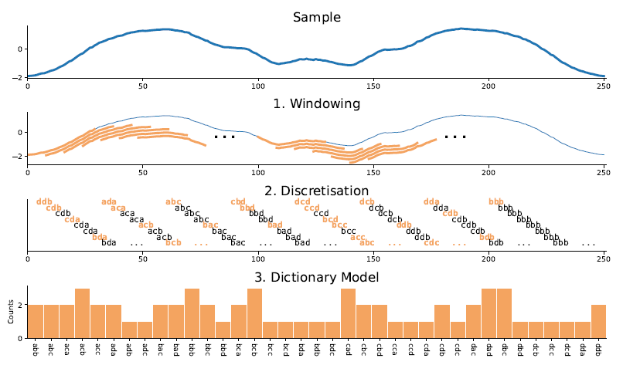
Issues with Padding - Examples
For bag-of-words models, adding padding will create histogram entries which just track the amount of padding on the series has.
For approaches which use nearest-neighbour, this is likely to just match series which have the closest length (and as such similar amount of padding) to each other.
20
Possible to mitigate i.e. feature selection, but some algorithms do not anticipate this.
Useless if AA is just the word derived from a window of padding
2
0
AA
AB
BA
BB

Slide 11
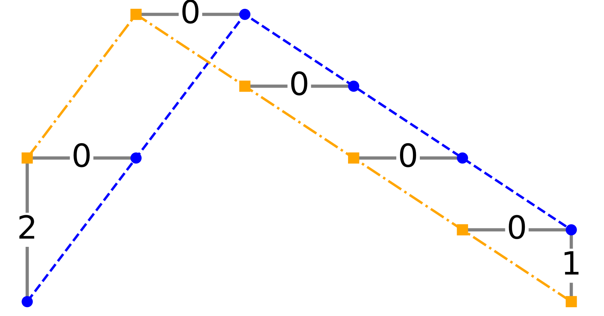
Natural Unequal Length Algorithms
Some types of algorithms can naturally handle unequal length. Warping in elastic distances can be used to calculate distance between different length series.
Shapelet distance (sDist) can be found regardless of length. If the shapelet is bigger than the series, you can swap them (or try to avoid generating large shapelets).
Elastic distances
Shapelets
0 | 3 | 9 | 14 | 1 | 2 | 7 | 1 | 2 | 1 | 15 | 2 | 10
-5 | 0 | 5
0 | 3 | 9
-1.07 | -0.267 | 1.336
3 | 9 | 14
9 | 14 | 1
-1 | 0 | 1
14 | 1 | 2
= 0.435
1 | 2 | 7

Slide 12


Also Resilient: Unsupervised Transforms
Transforms which look at all series independently are also a viable way of dealing with unequal length, as the resulting feature vector will be the same size.
Max | Min | … | Mean | 25% Q | Class
10 | 3 | … | 5 | 10 | Blue
8 | 2 | … | 4 | 8 | Blue
10 | 2 | … | 5 | 4 | Red
8 | 1 | … | 4 | 2 | Red

Slide 13
Not (easily) Usable: Intervals
These selected intervals are at the same timepoints for all series.
What happens when there is not enough time points? Are we going to be wasting selected intervals on unusually large series?
Outputs NaN?
Even if we preprocess
will the features we are
looking for align properly?

Slide 14
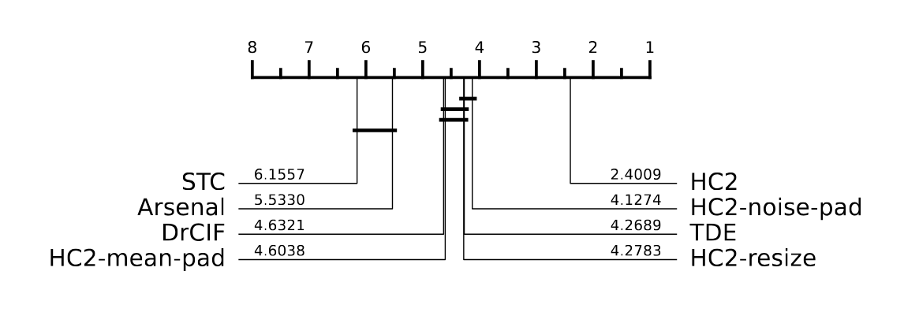
HC2 for imbalanced Data
Results for (currently unpublished) unequal length TSC approaches on UCR archive datasets altered to contain unequal length series.
Pre-processing HIVE-COTE performs significantly worse than versions of HIVE-COTE where unequal length is handled internally

Slide 15
Class Imbalance

Slide 16

Class Imbalance
Data-Level Approaches
Undersampling: Reduces majority class samples (less frequent due to data loss risk).
Oversampling: Increases minority-class samples (more prominent, preserves original info).
Examples: SMOTE, ADASYN.
Algorithm-Level Approaches
Cost-Sensitive Learning: Assigns higher misclassification costs to minority class samples
Other Techniques: Decision threshold adjustment, ensemble of one-class classifiers, modified loss functions.
Notes:
In general, there are two main approaches: changing the data, or changing how the model learns.
On the left, we have Data-Level Approaches. These modify the dataset itself.
Undersampling reduces the number of majority class samples. The downside is that we might throw away useful information.
Oversampling increases the number of minority class samples, either by duplicating them or generating new ones. This keeps the original data intact and makes the rare class more visible. Common methods include SMOTE and ADASYN.
On the right, we have Algorithm-Level Approaches. These change the way the model learns from the data.
A key idea here is Cost-Sensitive Learning. We assign a higher cost to mistakes on the minority class, so the model pays more attention to it.
Other techniques include adjusting decision thresholds, using one-class models, or modifying the loss function to focus more on rare cases.
These are the basic strategies for handling class imbalance.

Slide 17
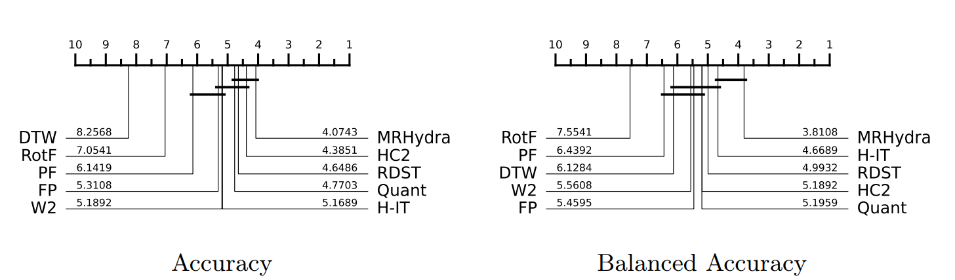
Motivation:
HC2 does relatively poorly with imbalanced data
Created 76 imbalanced binary classification datasets.
Notes:
In general, there are two main approaches: changing the data, or changing how the model learns.
On the left, we have Data-Level Approaches. These modify the dataset itself.
Undersampling reduces the number of majority class samples. The downside is that we might throw away useful information.
Oversampling increases the number of minority class samples, either by duplicating them or generating new ones. This keeps the original data intact and makes the rare class more visible. Common methods include SMOTE and ADASYN.
On the right, we have Algorithm-Level Approaches. These change the way the model learns from the data.
A key idea here is Cost-Sensitive Learning. We assign a higher cost to mistakes on the minority class, so the model pays more attention to it.
Other techniques include adjusting decision thresholds, using one-class models, or modifying the loss function to focus more on rare cases.
These are the basic strategies for handling class imbalance.

Slide 18

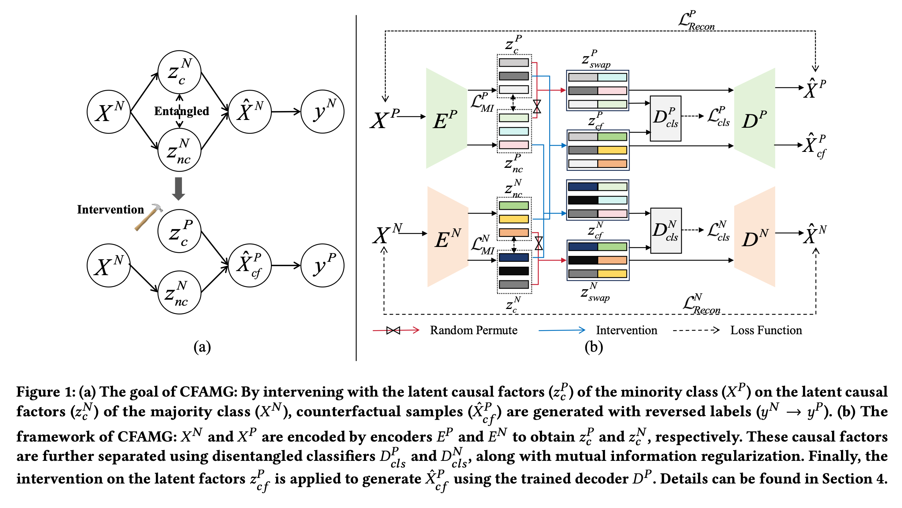
CounterFactual Augmentation Minority Generation (CFAMG)
51 data from UCR and UEA time series repository (mixed univariate and multivariate) to construct imbalanced data
Assessed with ResNet, MLP and LLTM
Notes:
CounterFactual Augmentation Minority Generation (CFAMG) method, a novel approach to addressing the problem of imbalanced time-series classification. Instead of relying on traditional oversampling techniques that focus on correlations and similarity-based heuristics, CFAMG leverages a causal perspective to identify the underlying factors that distinguish the majority and minority classes. The method uses a generative model with a dual VAE architecture to first disentangle causal and non-causal factors from both majority and minority class samples. It then performs a "counterfactual intervention" by swapping the causal factors of majority class samples with those from the minority class to create new, synthetic minority samples. The authors used 53 time series datasets sourced from the UCR and UEA time series repository to construct imbalance datasets.

Slide 19
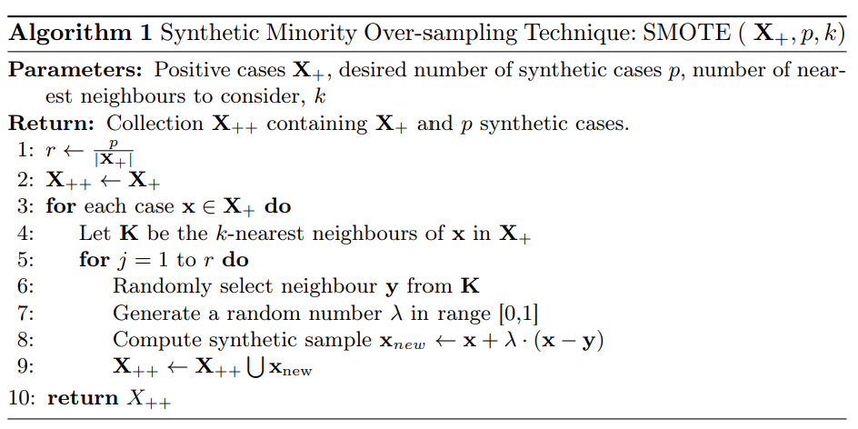

SMOTE is often criticized but is very popular
Notes:
Elastic-SMOTE.
oversampling methods like SMOTE are widely used to handle imbalanced data.
However, standard SMOTE doesn’t work well for time series, because it relies on simple distance measures like Euclidean distance, which don’t handle misalignments. Two time series may have the same shape but be shifted in time — and Euclidean distance won’t capture that.
To fix this, we bring in Elastic Distances, like Dynamic Time Warping（wɔːp） (DTW), which allow flexible alignment between time series by stretching or compressing them. This gives a more accurate sense of similarity.

Slide 20
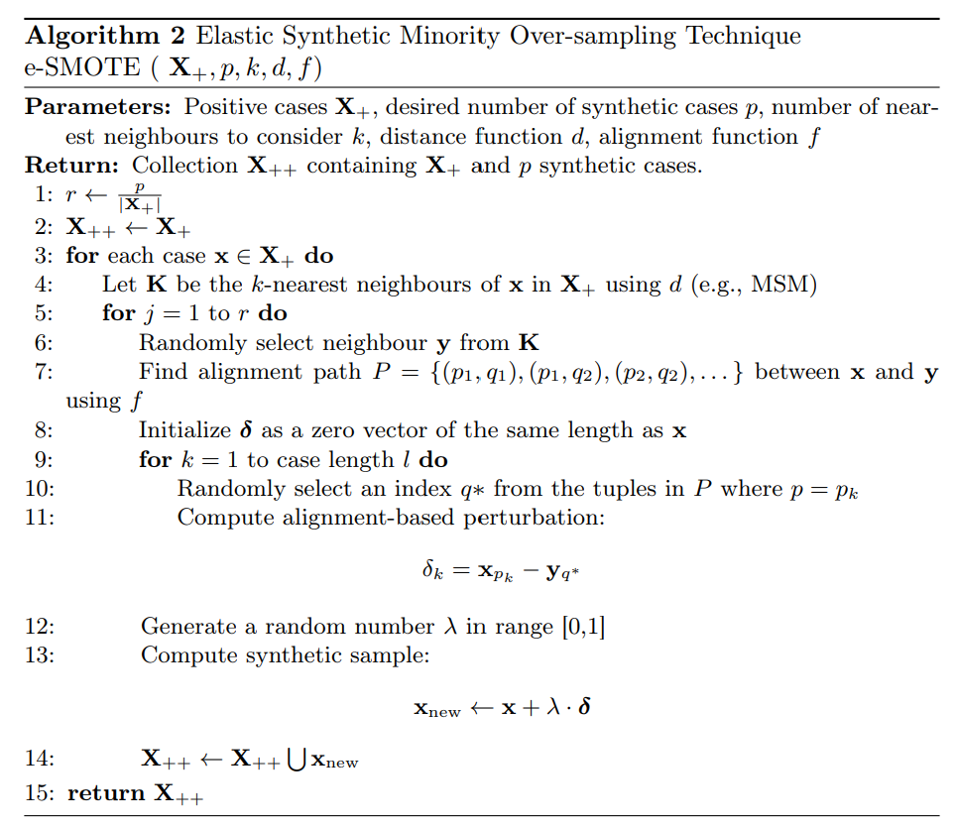
Use MSM to find neighbours
Create a weighting using the alignment path
Create a synthetic in the same style as SMOTE
Notes:
Elastic-SMOTE.
oversampling methods like SMOTE are widely used to handle imbalanced data.
However, standard SMOTE doesn’t work well for time series, because it relies on simple distance measures like Euclidean distance, which don’t handle misalignments. Two time series may have the same shape but be shifted in time — and Euclidean distance won’t capture that.
To fix this, we bring in Elastic Distances, like Dynamic Time Warping（wɔːp） (DTW), which allow flexible alignment between time series by stretching or compressing them. This gives a more accurate sense of similarity.

Slide 21
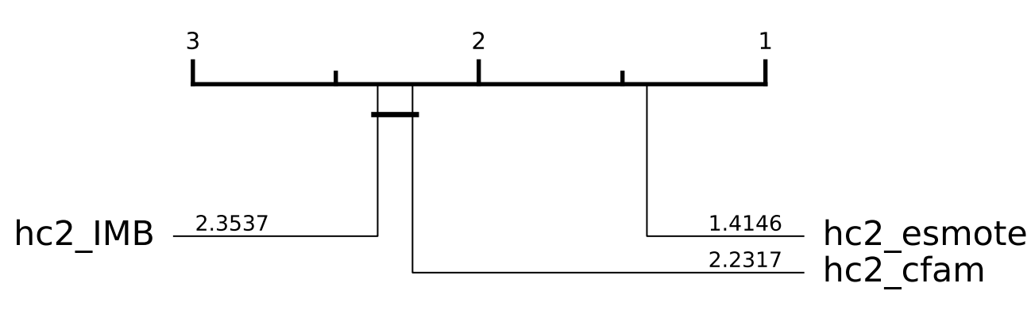
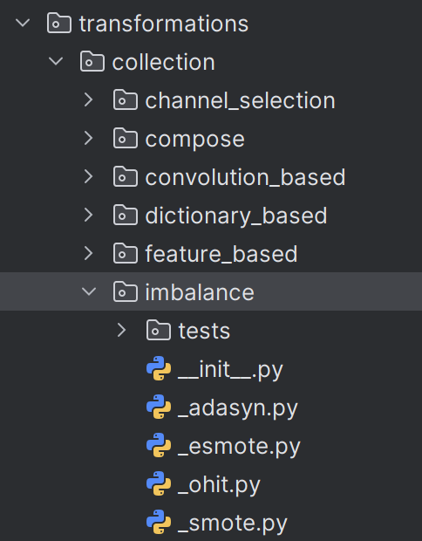
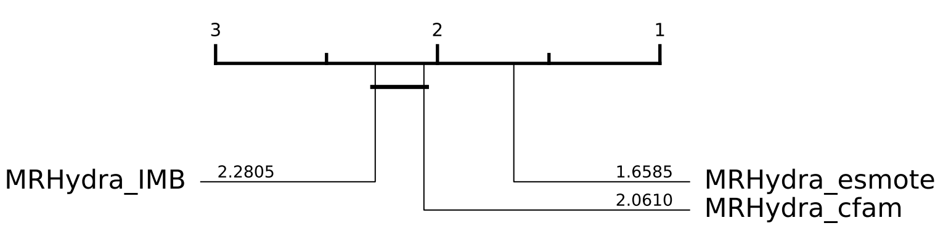
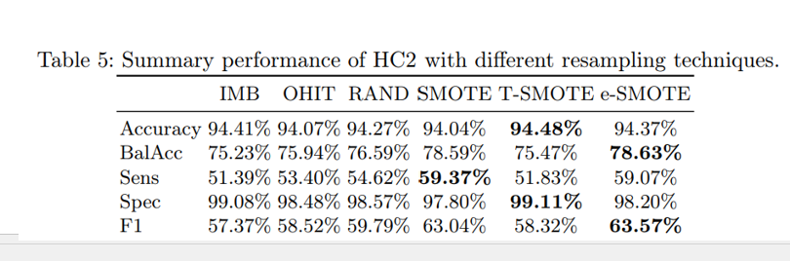
Balanced Accuracy
Notes:
Elastic-SMOTE.
oversampling methods like SMOTE are widely used to handle imbalanced data.
However, standard SMOTE doesn’t work well for time series, because it relies on simple distance measures like Euclidean distance, which don’t handle misalignments. Two time series may have the same shape but be shifted in time — and Euclidean distance won’t capture that.
To fix this, we bring in Elastic Distances, like Dynamic Time Warping（wɔːp） (DTW), which allow flexible alignment between time series by stretching or compressing them. This gives a more accurate sense of similarity.

Slide 22
Channel Selection

Slide 23
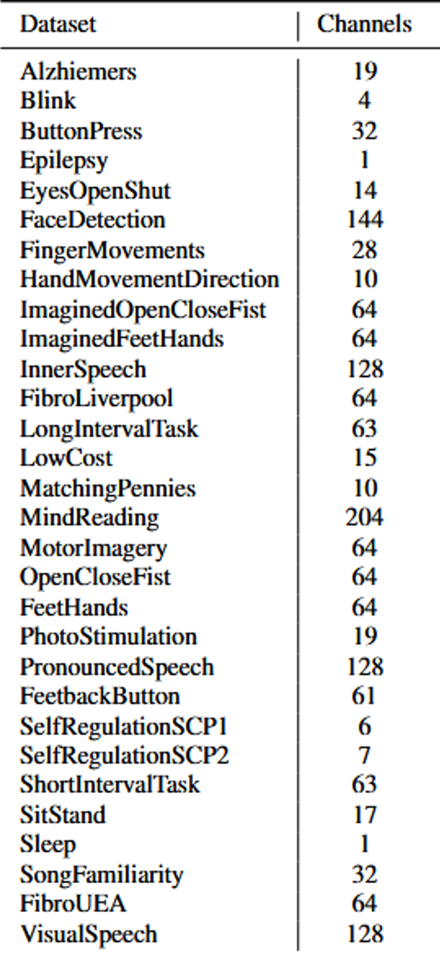
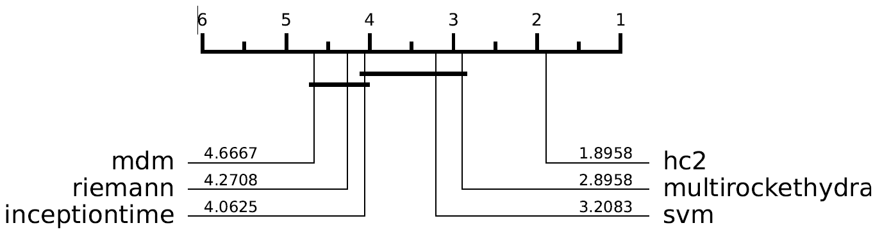
Results
EEG Classification
Time series methods outperform other approaches
HIVE-COTE 2 significantly better than all other methods
But extremely slow, on average 55 times slower than the second slowest
Channel Selection

Slide 24
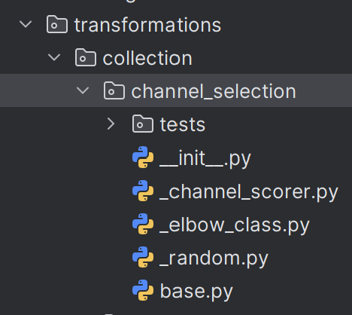
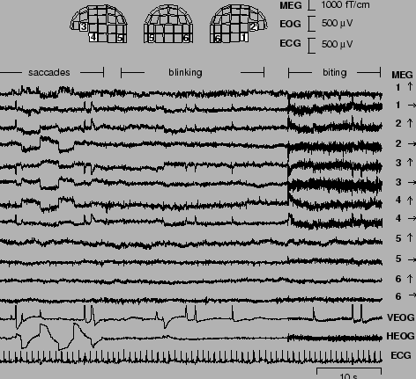
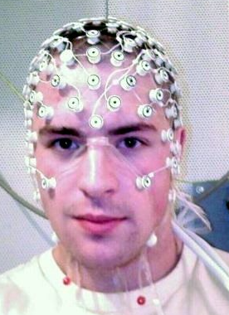
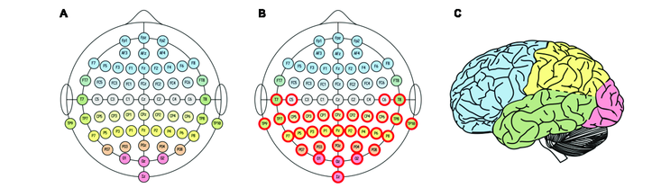
Channel Selection for EEG
Not all channels contain useful information
Useful channels represent important regions of the brain
Normally manual process requiring expert knowledge
Automatic methods proposed but rarely fully evaluated

Slide 25
Elbow Sum (ECS) and Riemannian based (RB)
Channel Selection Algorithms
Create class prototypes for each class
Calculate distance matrix between distance centroids for each channel
Select optimal channels based on sum of total distance
Elbow Sum uses Euclidean
Riemannian uses Riemannian distance
ROCKET Wrapper (RW) and Detached Rocket (RD)
Use a fast univariate classifier as a proxy for quality
Train classifier on each channel, select highest accuracy
Rank features based on performance, select channels used in those features
Binary Particle Swarm Optimisation (BPSO)
Create randomised subsets of channels, train classifier on each subset. Adjust channel subsets based on results.
Creates new channels rather than selecting optimal. Aims to maximise difference in variance
Included due to its popularity with EEG data
Common Spatial Patterns (CSP)

Slide 26
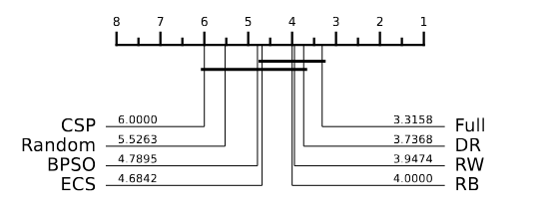
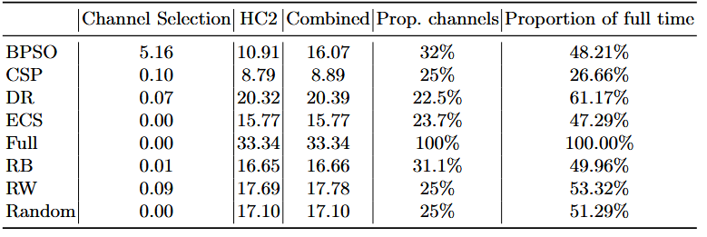
Ranks in terms of Log-Loss
No major differences found between channel selection methods tested.
CSP overall ranked worst in both measures, followed by random selection
ROCKET based methods performed best overall

Slide 27
Archives

Slide 28
time series classification has not yet had its ‘ImageNet moment’, simply because in almost all existing work the quantity of training data has been insufficient to allow for training low bias models such as large convolutional neural networks or transformer architectures effectively
Models such as large deep neural networks are low bias models, and require significant quantities of training data in order to achieve competitive accuracy compared to less complex models.
Current research likely unjustifiably favours methods that not only minimise variance, but that achieve low 0–1 loss on average, with potentially limited relevance to any specific real-world application
The methods which achieve the lowest 0–1 loss on larger datasets will differ from the methods which achieve the lowest 0–1 loss on smaller datasets.

Slide 29
New Repositories
MONSTER: 29 big problems (Monash)
EEG: 30+ EEG classification problems (Soton)
Rehab-Pile: 60 motion from video classification problems (Haute-Alsace)
New MTSC 100+ MTSC problems, advance on UEA archive (Soton, Monash and Haute-Alsace)
Imbalance: 76 artificially imbalanced datasets (Soton)
Unequal length: still not finalised (Soton)

Slide 30

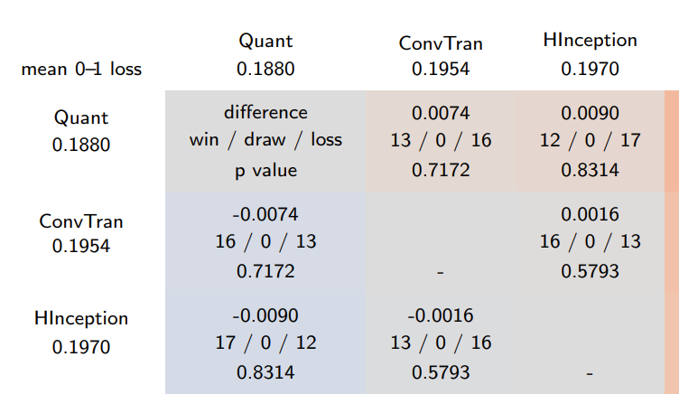
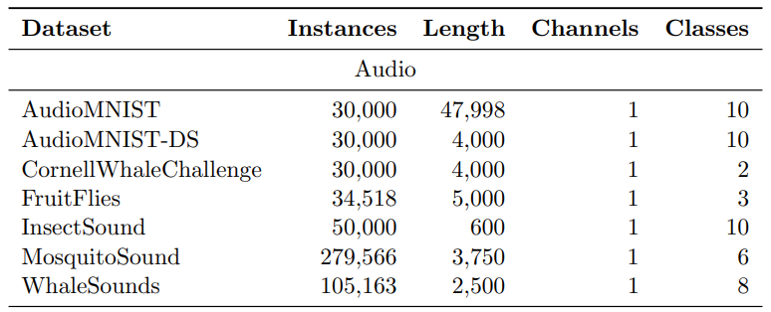
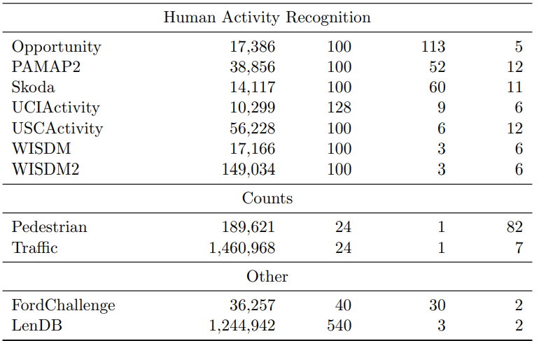
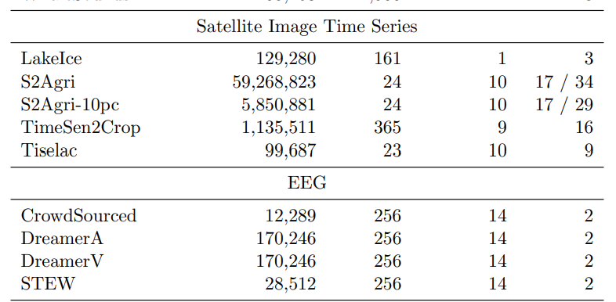

Slide 31
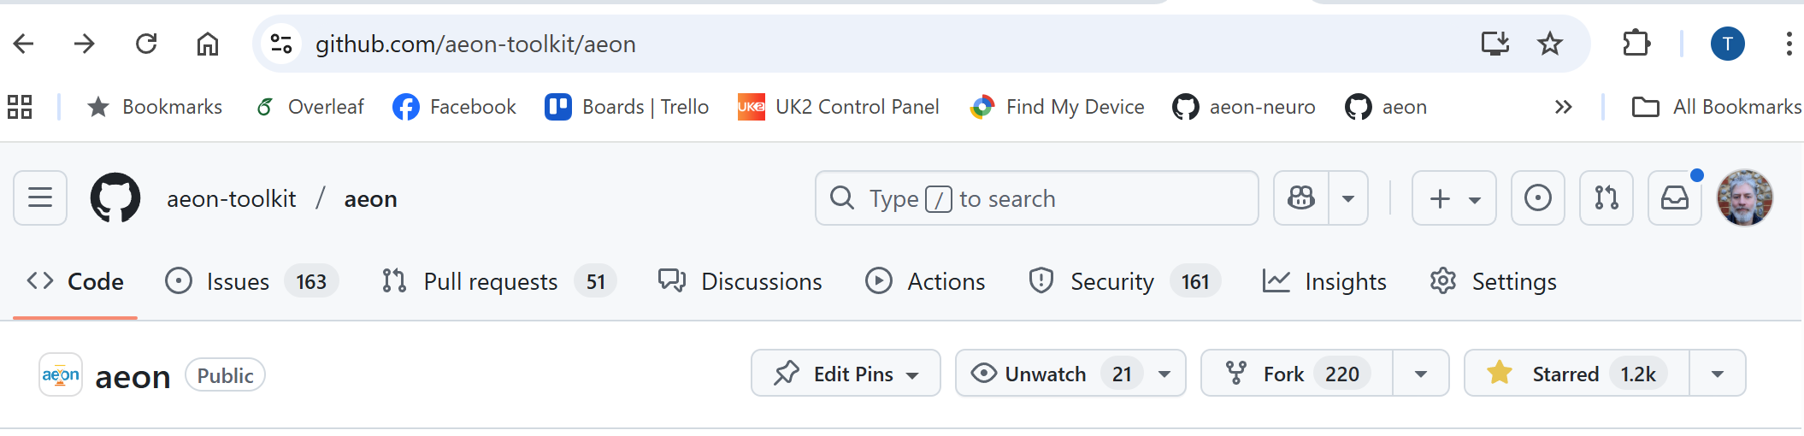
Thank you, and questions?

